Slide 1

Transportation Network and COVID19 Chicago

Slide 2
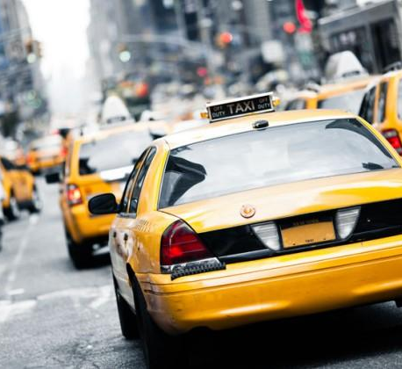


DATA SOURCE
Car crashes (2018, 2019, 2020) 328,795 crashes
Transportation Network Providers TNP (Ride-share) (2019, 2020) 161,846,465 trips
Taxi Companies (2019, 2020) 20,365,840 trips

Slide 3
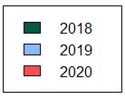
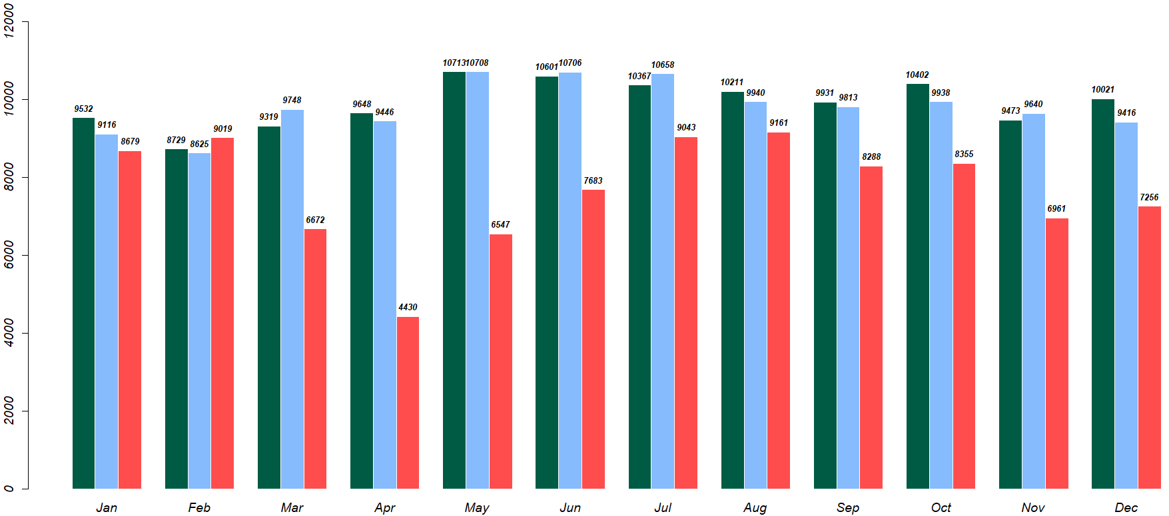
Monthly Car Crashes

Slide 4
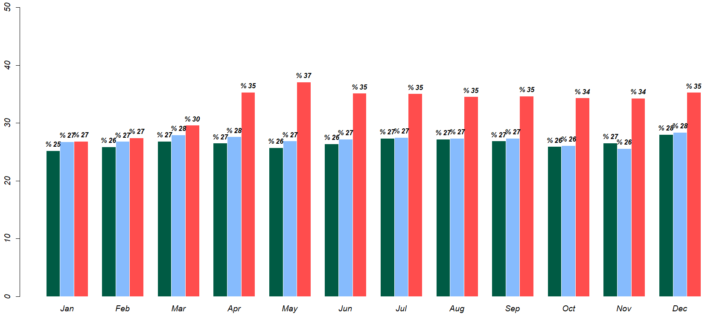
Monthly Hit and Run Percentage

Slide 5
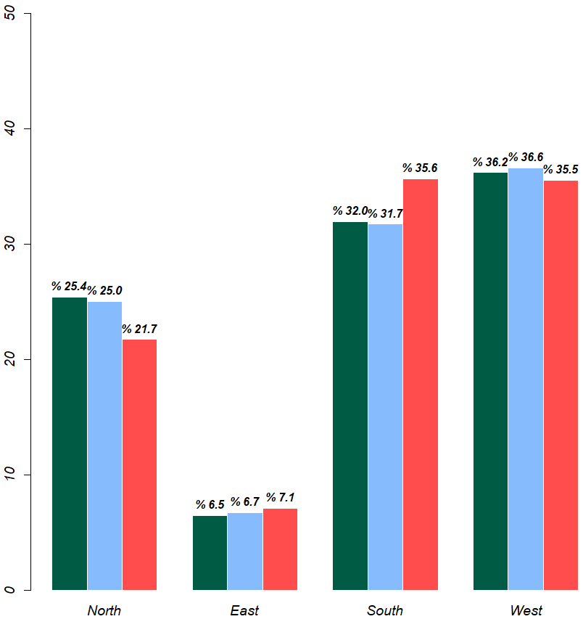
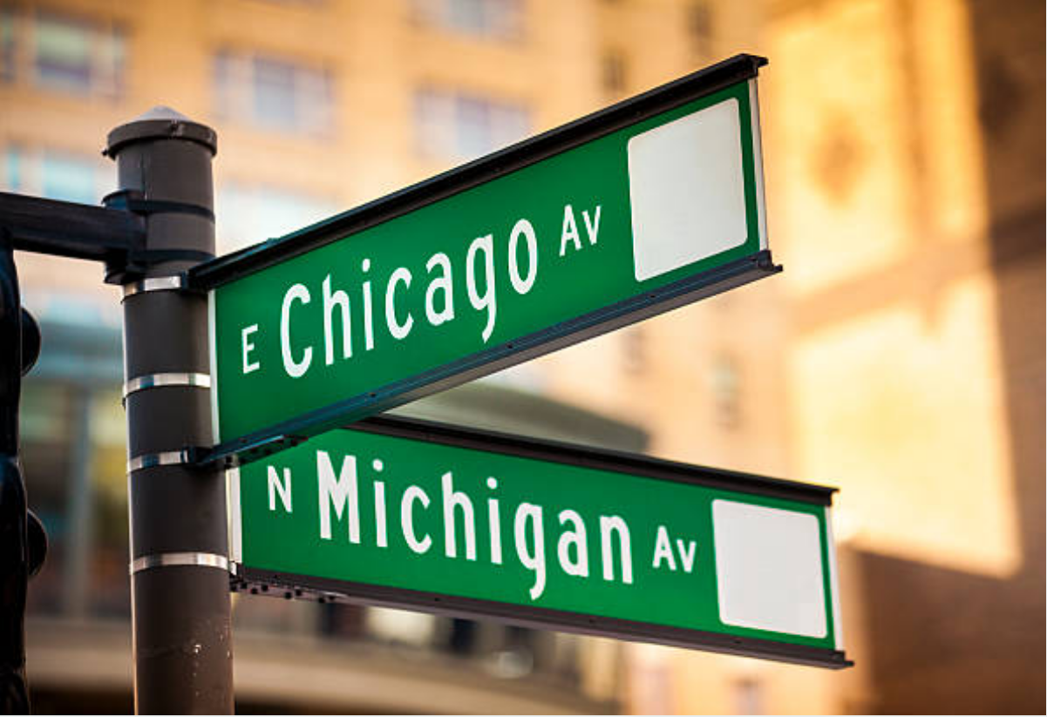
Crashes Percentage By Street Direction

Slide 6

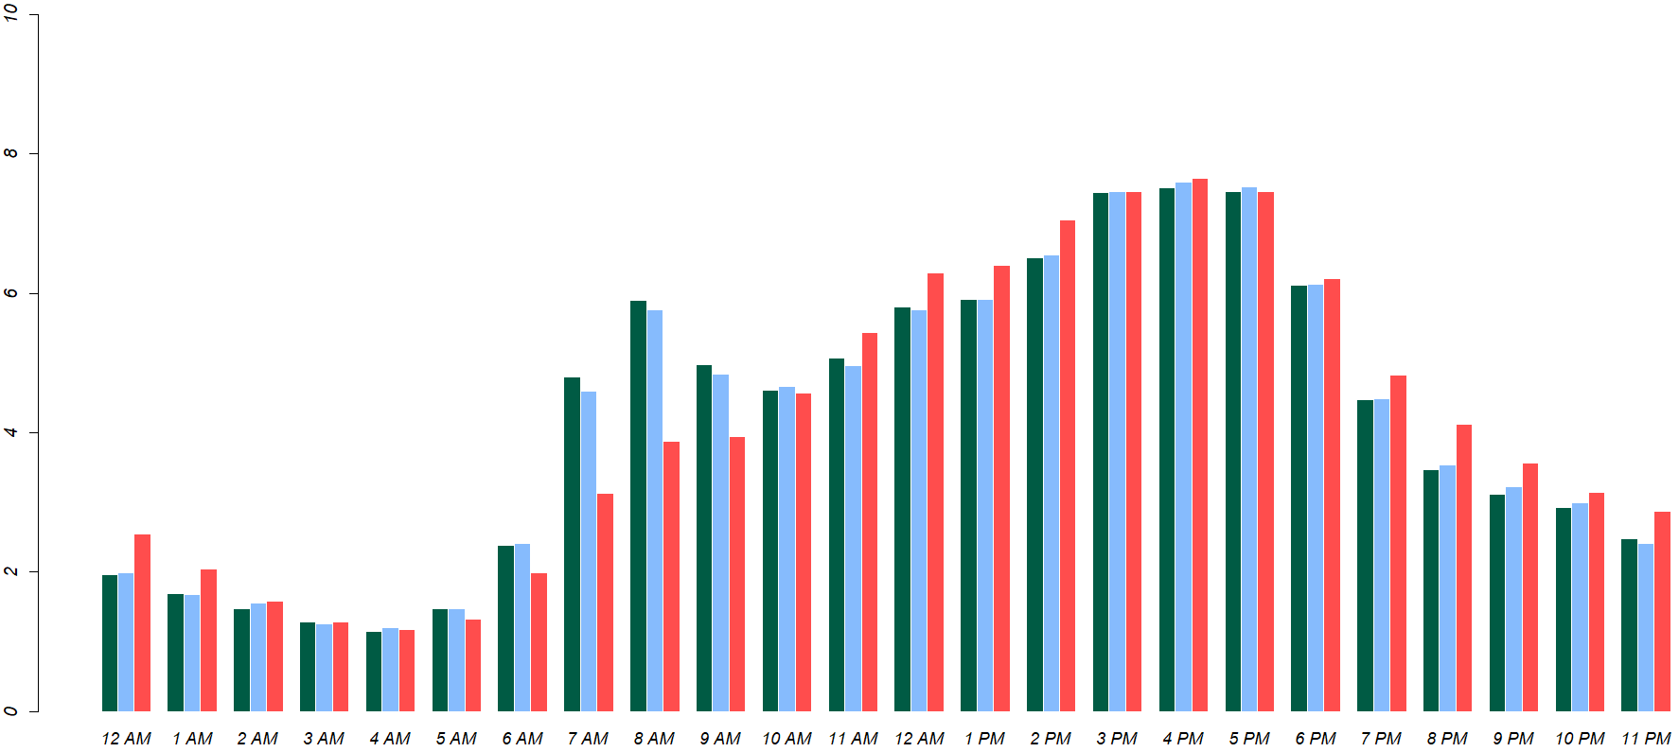
Crashes Percentage By Hour

Slide 7
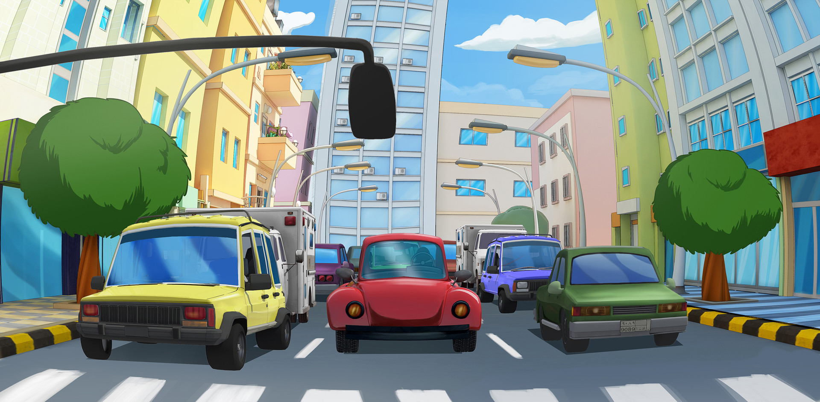
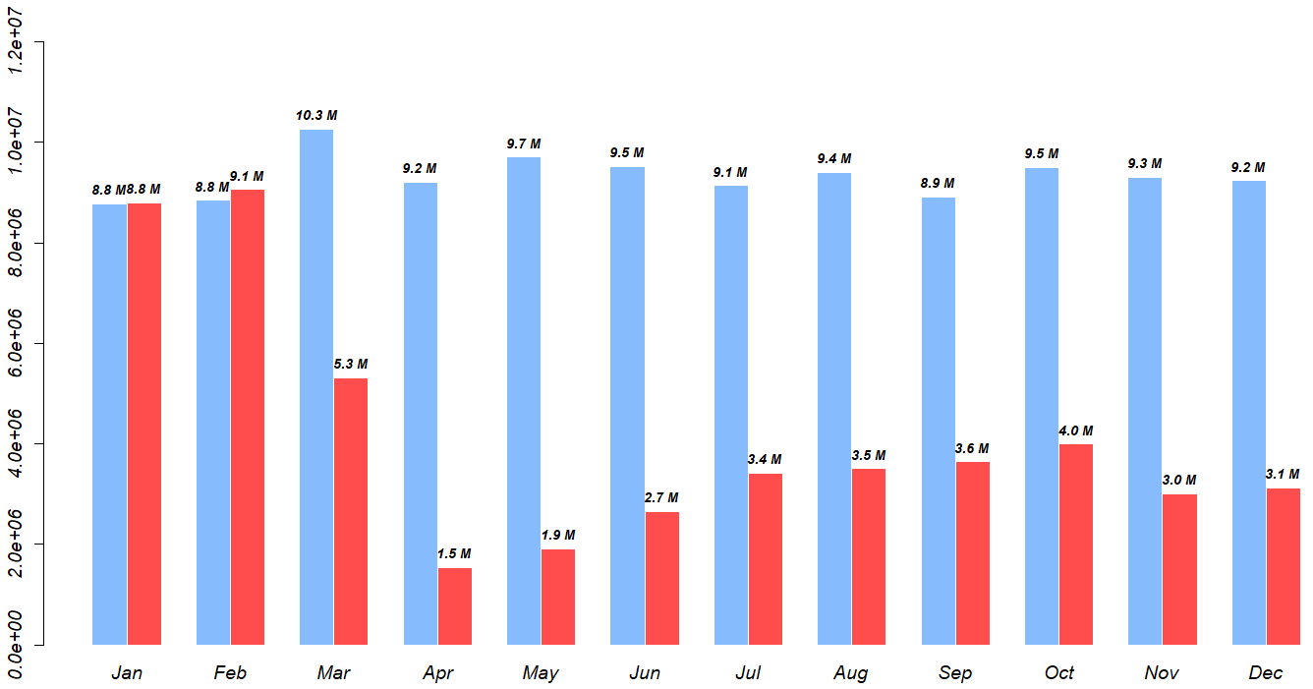
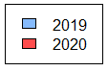
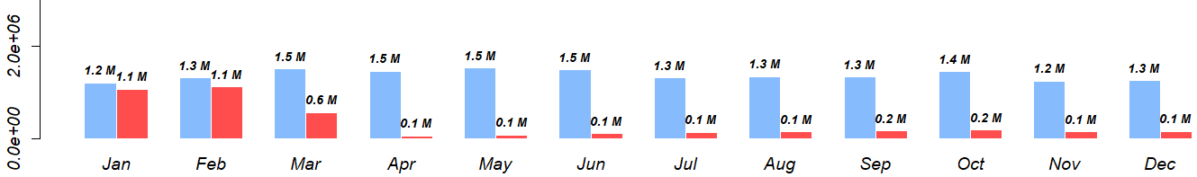
Monthly Ride-share and Taxi Trips
Ride-share trips
TAXI trips

Slide 8
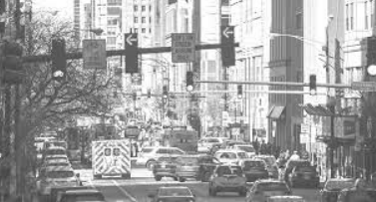
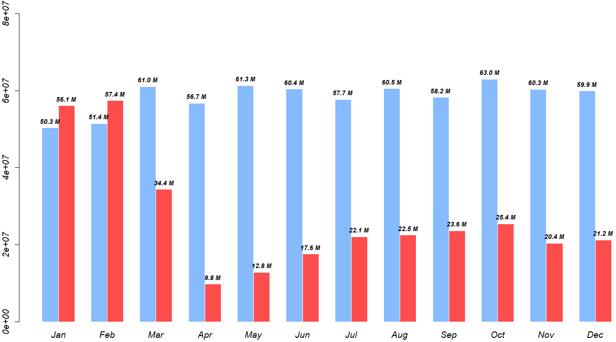
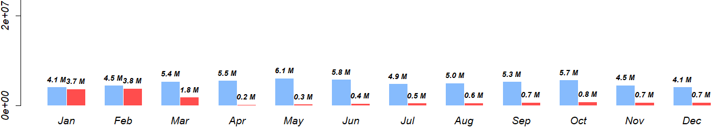
Monthly Ride-share and Taxi Miles Traveled
Ride-share miles
TAXI MILES

Slide 9
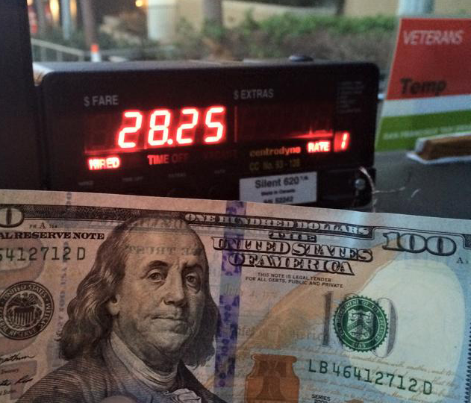
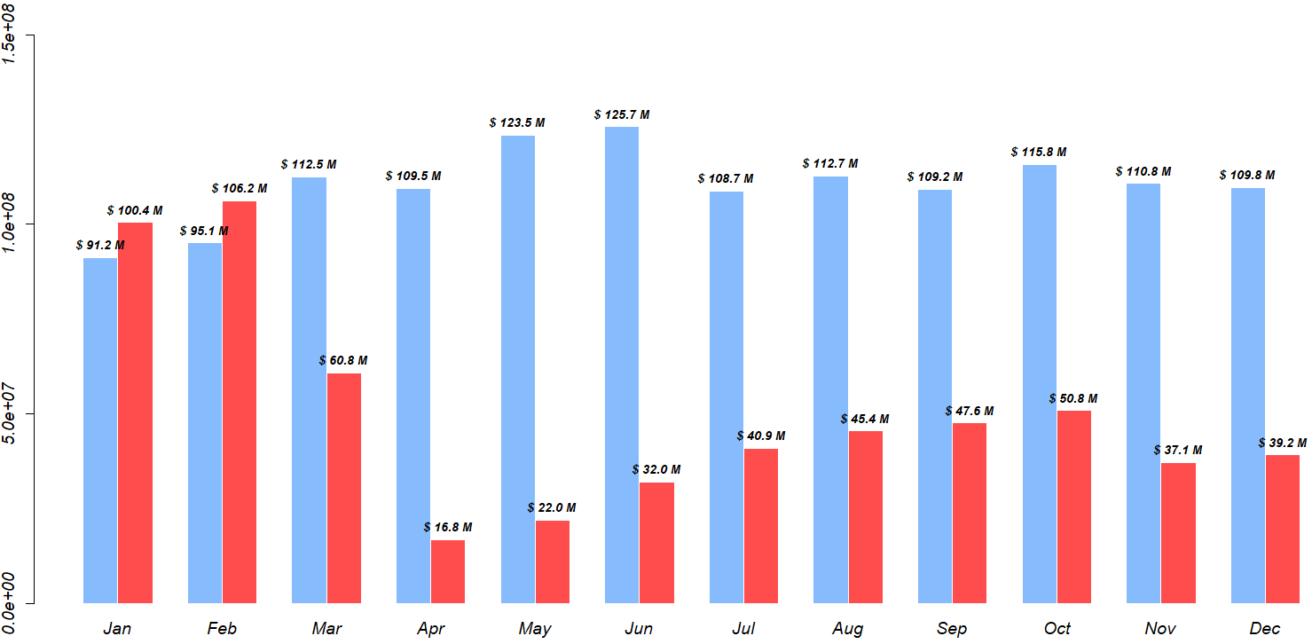
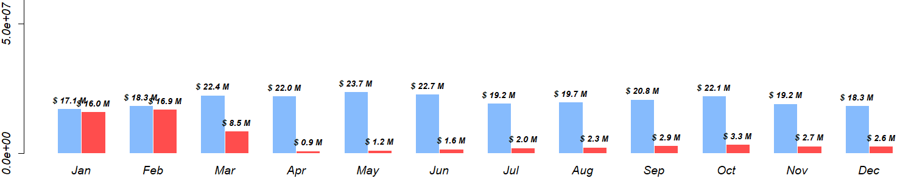
Monthly Ride-share and Taxi Total Fares
Ride-share fares
TAXI fares

Slide 10

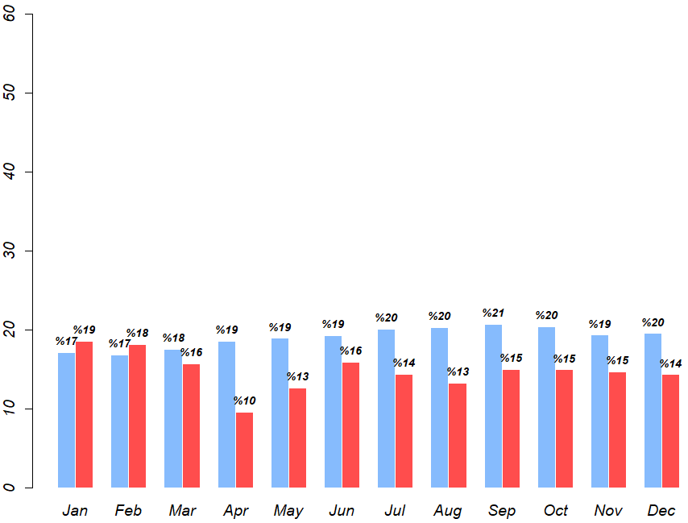
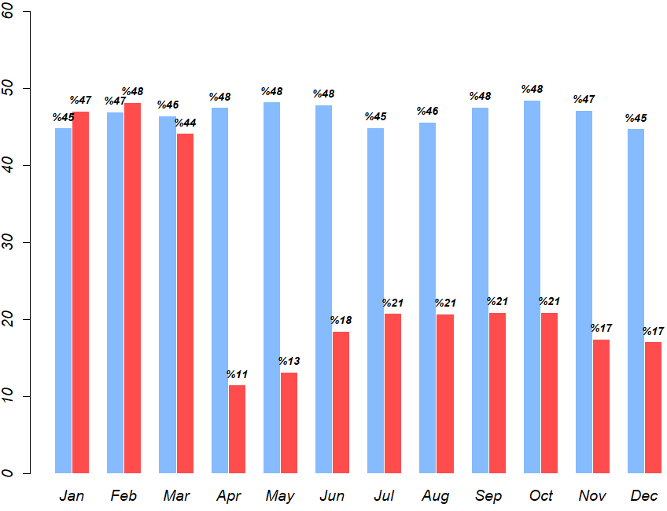
Monthly Ride-share and Taxi Tippers Percentage
Ride-share Tippers
TAXI tippers

Slide 11

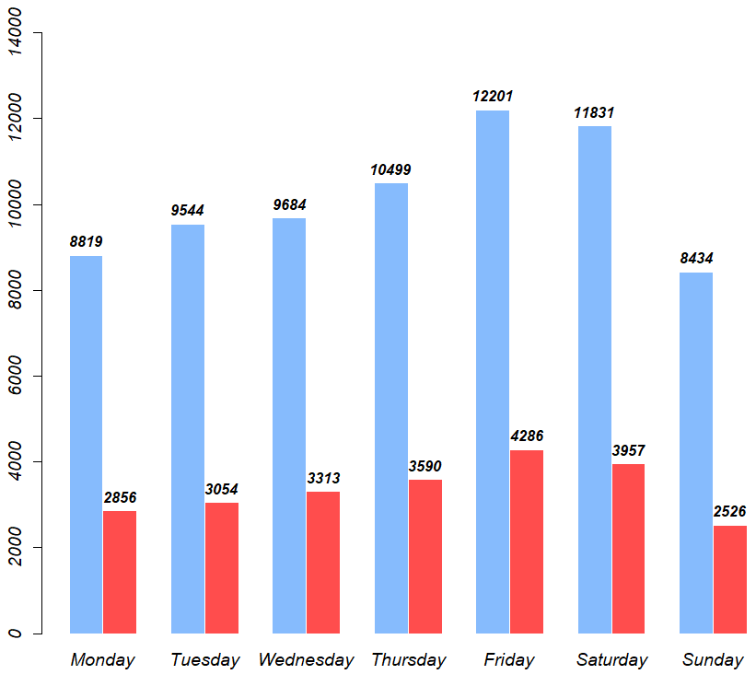
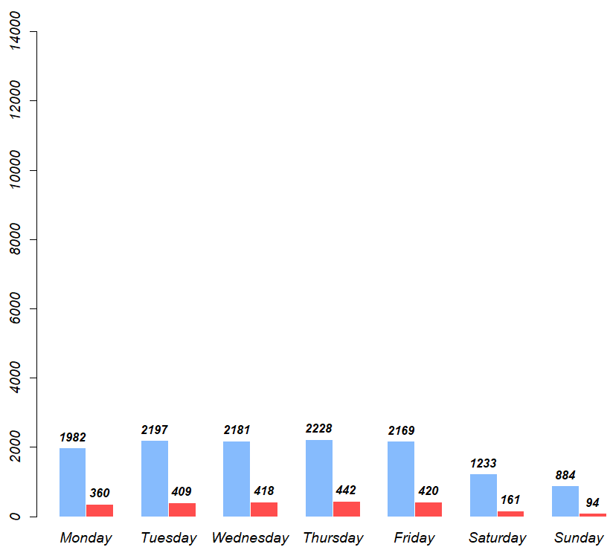
Daily Average Ride-share and Taxi Trips To Hospitals
Ride-share trips to hospitals
TAXI trips to hospitals

Slide 12
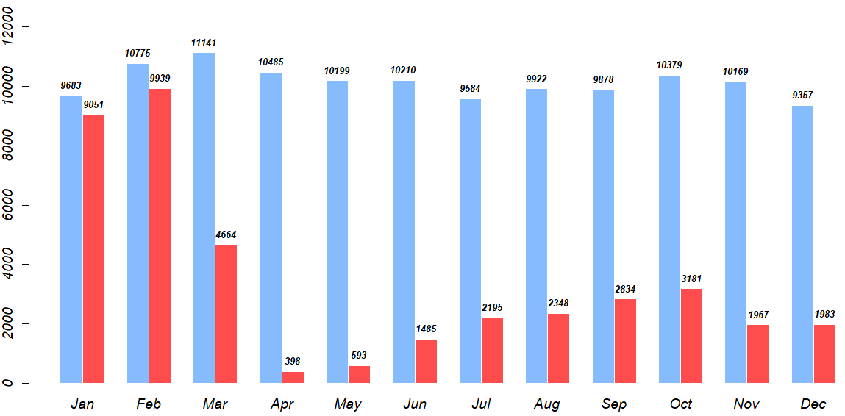
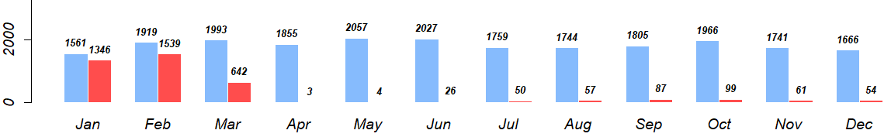
Daily Average Ride-share and Taxi Trips To Hospitals
Ride-share trips to hospitals
TAXI trips to hospitals

Slide 13


O’Hare and Midway airports
Taxi and Ride-share rides to and from each airport

Slide 14

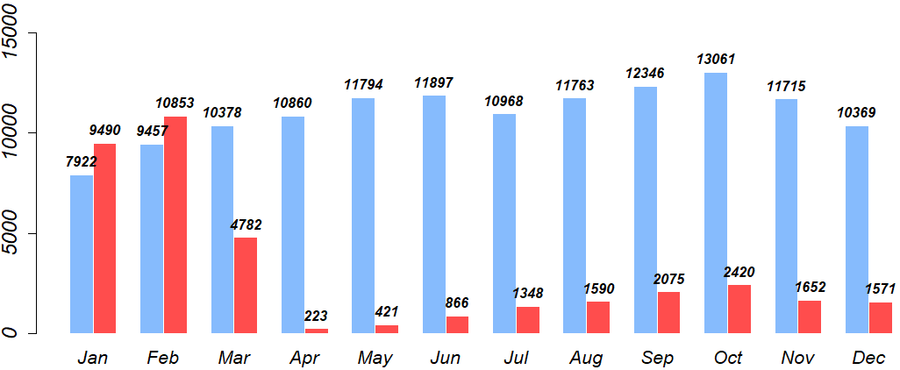
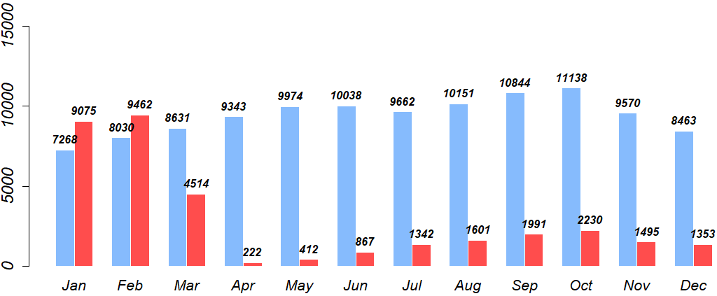

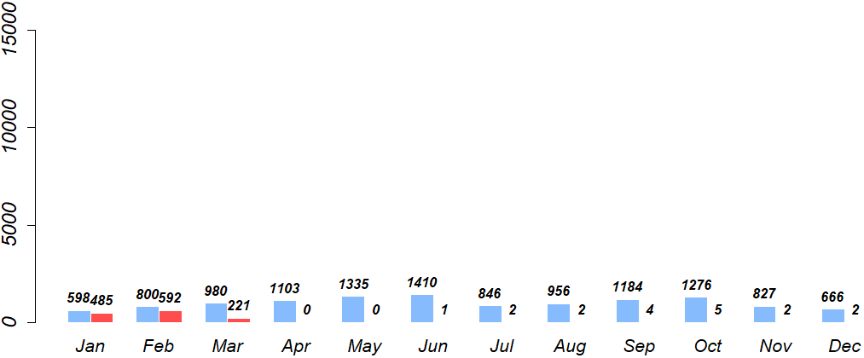
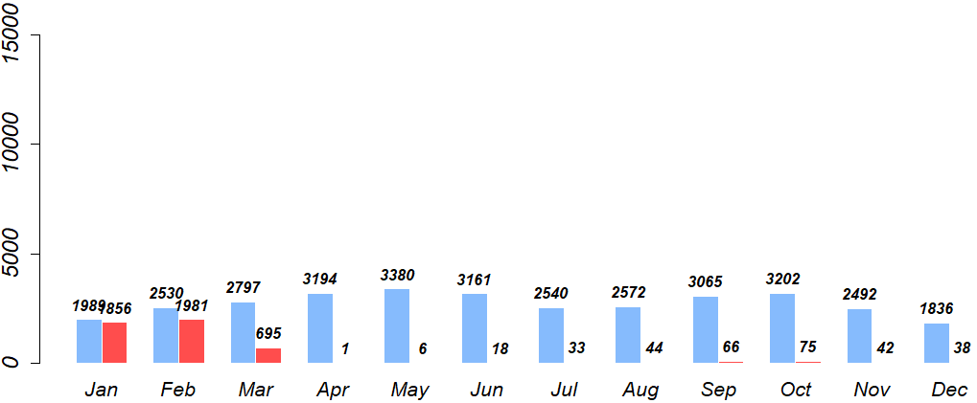
O’Hare Airport Daily Average Ride-share and Taxi Trips
Ride-share drop-offs
Ride-share pickups
taxi drop-offs
taxi pickups

Slide 15
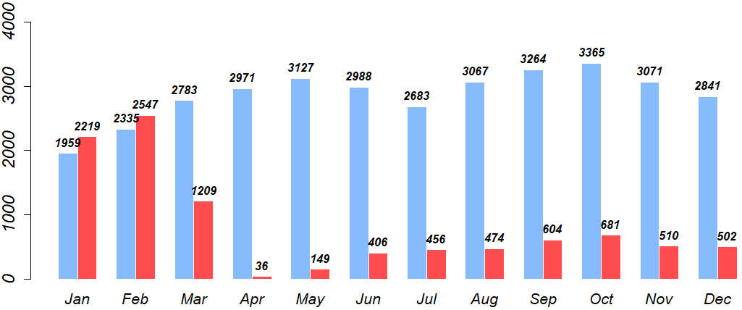
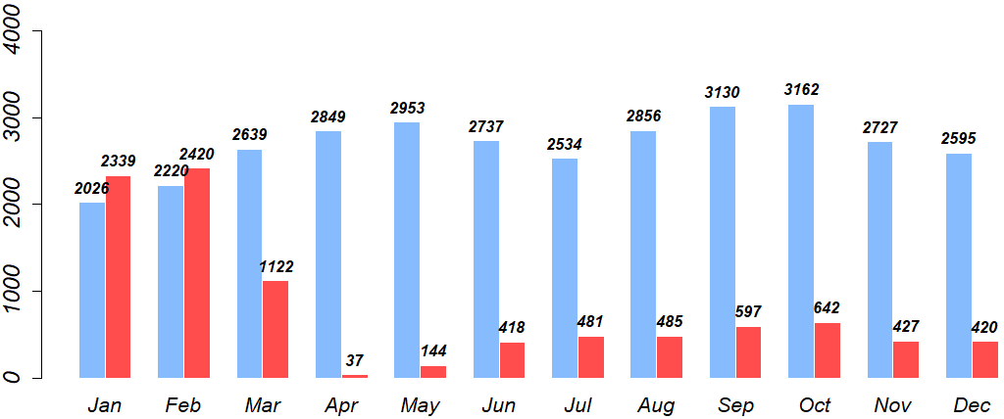
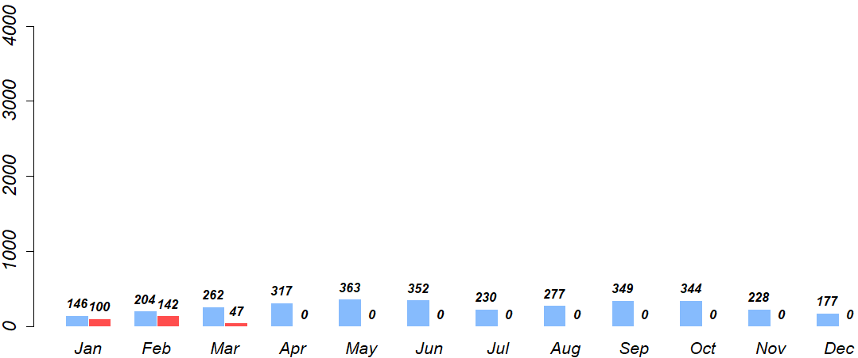
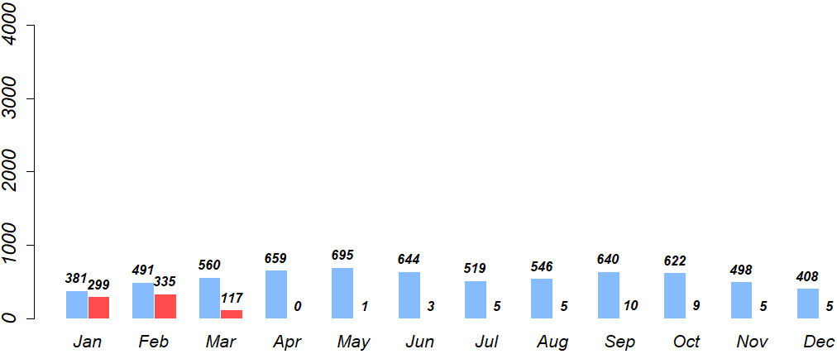
Midway Airport Daily Average Ride-share and Taxi Trips
Ride-share drop-offs
Ride-share pickups
taxi drop-offs
taxi pickups

Slide 16
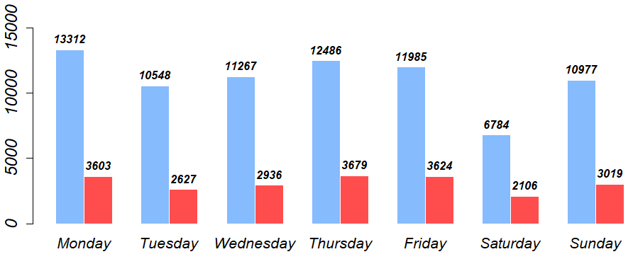
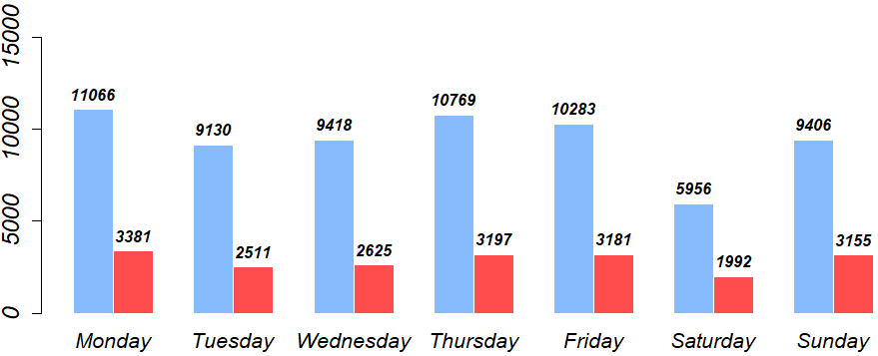
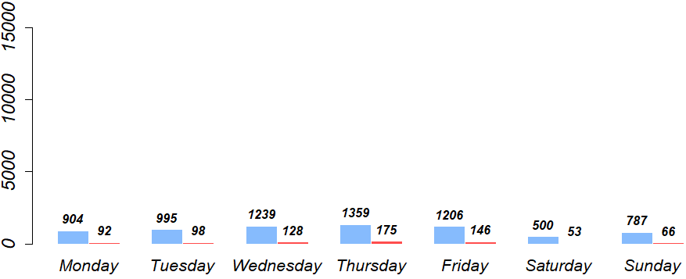
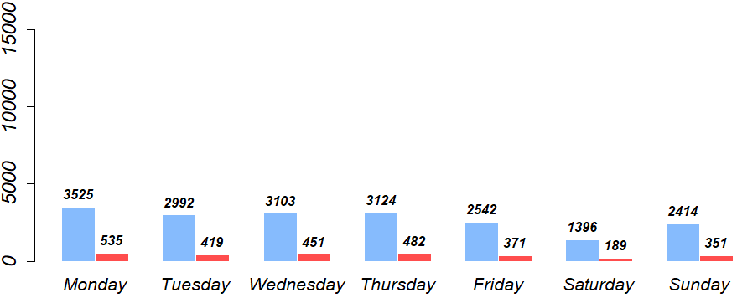
O’Hare Airport Daily Average Trips
Ride-share drop-offs
Ride-share pickups
taxi drop-offs
taxi pickups

Slide 17
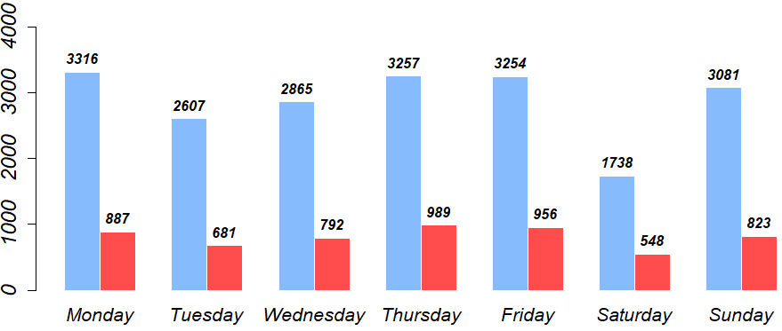
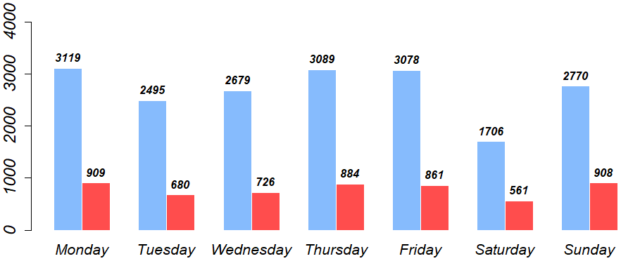
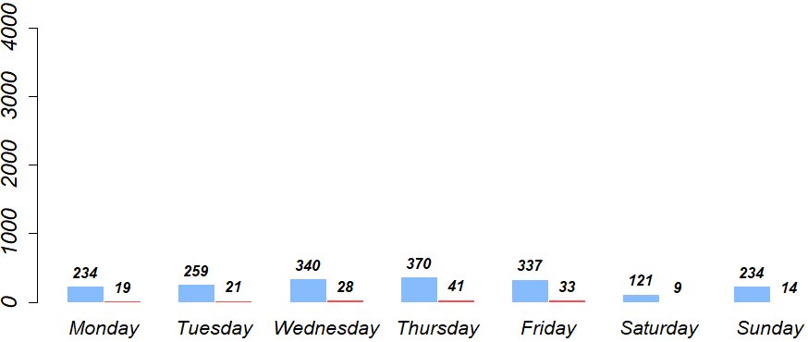
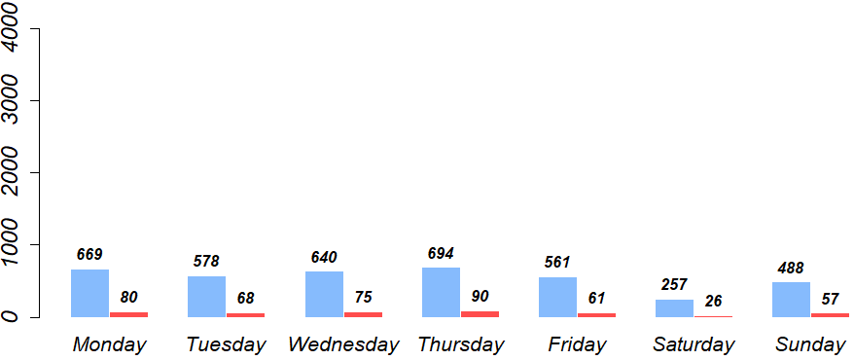
Midway Airport Daily Average Trips
Ride-share drop-offs
Ride-share pickups
taxi drop-offs
taxi pickups

Slide 18
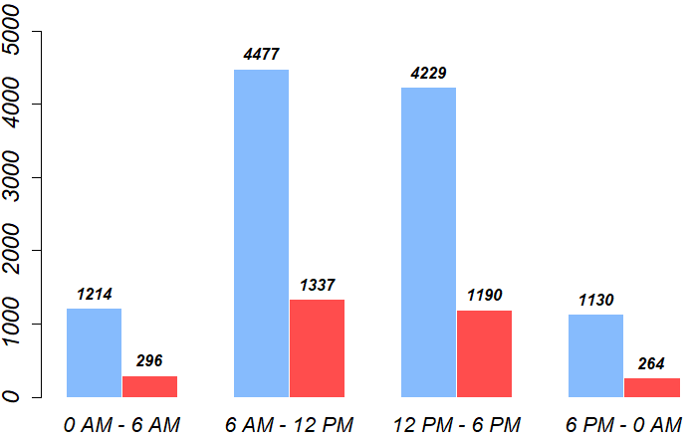
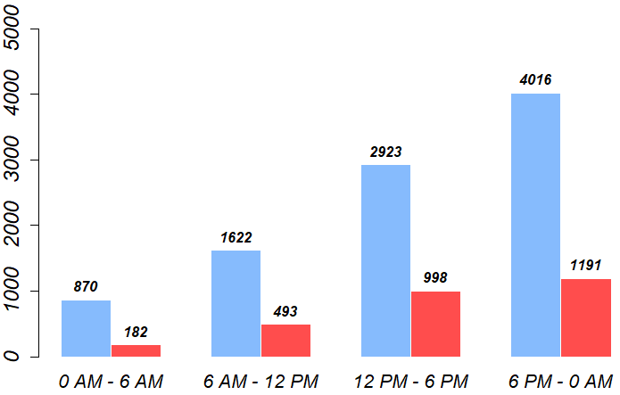
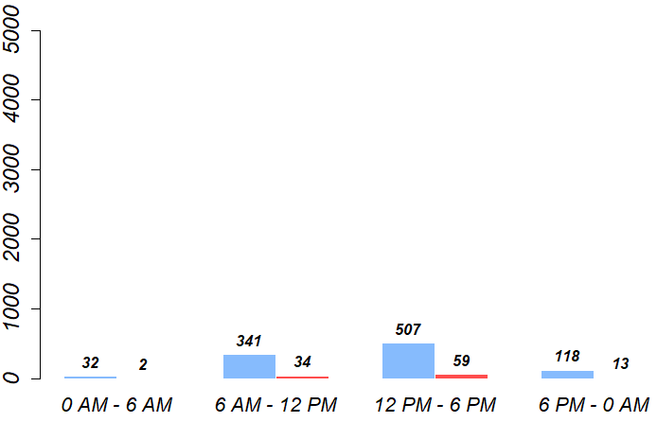
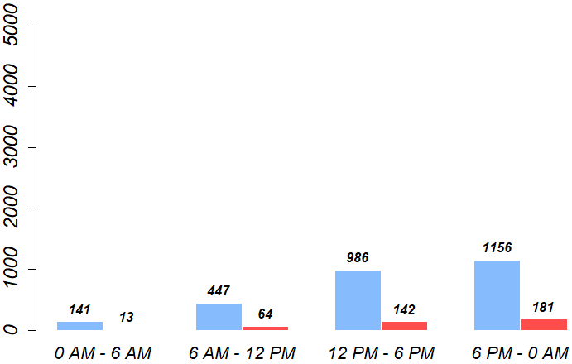
O’Hare Airport Daily Average Trips
Ride-share drop-offs
Ride-share pickups
taxi drop-offs
taxi pickups

Slide 19
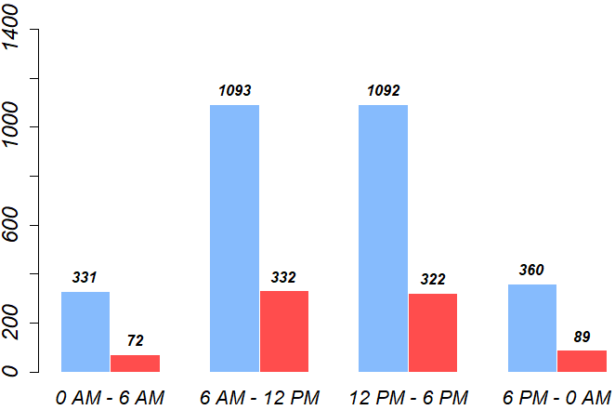
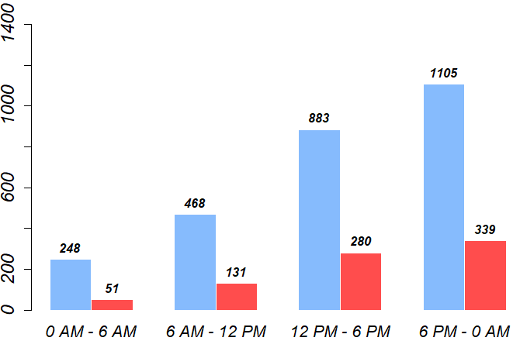
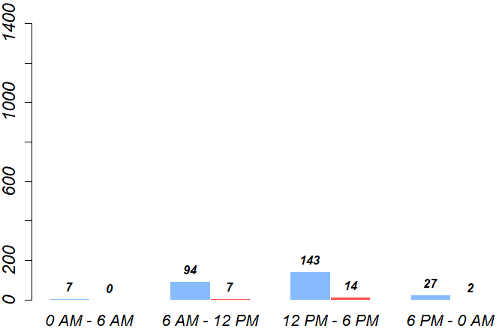
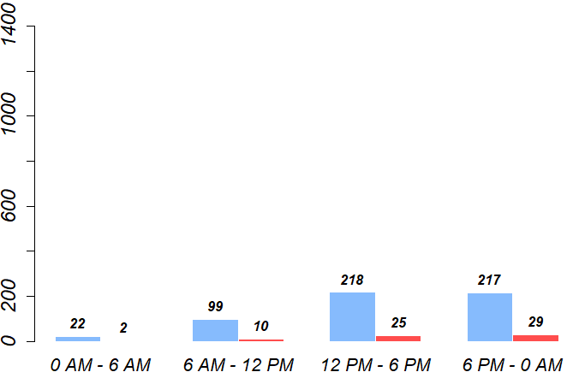
Midway Airport Daily Average Trips
Ride-share drop-offs
Ride-share pickups
taxi drop-offs
taxi pickups

Slide 20
Conclusion
Car crashes decreased during the pandemic
Monthly hit and run crashes percentage increased
Crashes percentage decreased during morning rush hours
Taxi rides decreased drastically
Ride-share business recovered better than taxis
People tip less in rideshares
Tippers percentage decreased in taxis the most
Rides to and from airports dropped dramatically
O’Hare rides are 3 times more than Midway’s

Slide 21
Contribution
Demonstrated transportation services in different times
Conducted comparisons between digital services and Taxis
Approached car crashes using multiple factors
Analyzed airport and hospital trips
Offered effective ways to understand the impact of COVID19 on transportation networks

Slide 22

Thank you!
ramadanfgannud@gmail.com

